Slide 1
You’re PROBABLY Wrong (An Introduction to Bayesian Thinking)
Timmy Lui
2025/04/10
Brown Bag

Slide 2



Slide 3
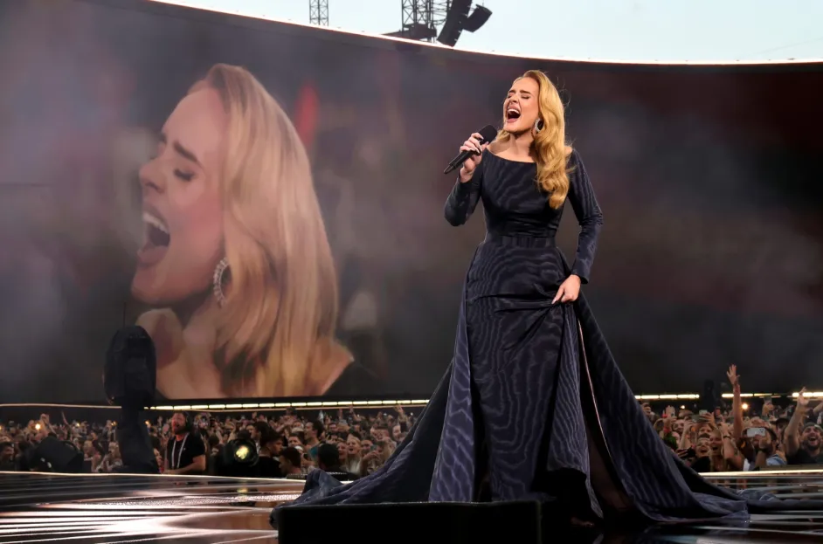
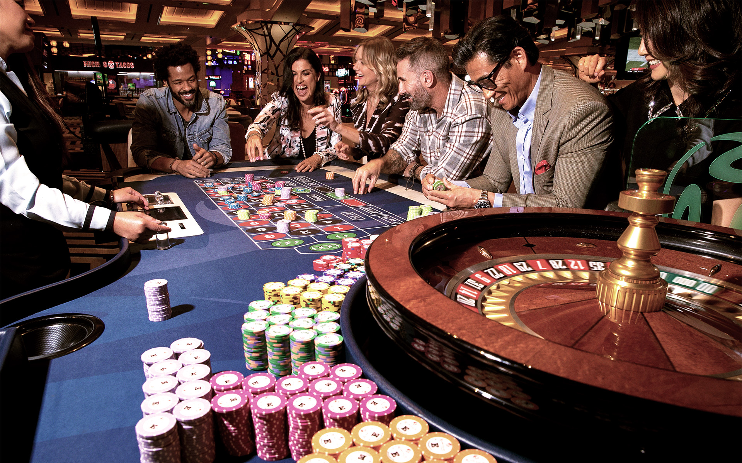
Adele is performing, one night only, at Bayes Casino

Slide 4
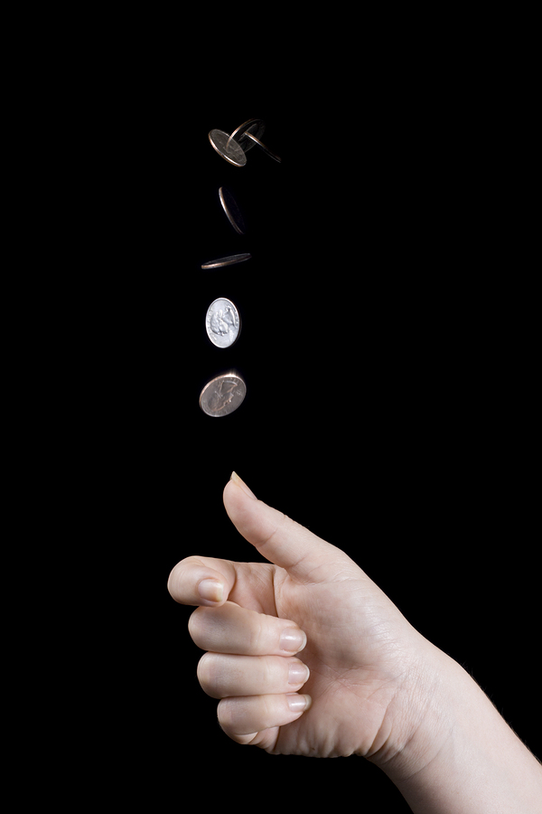
The Coin Flip Game
The teller says the win multiplier is x3.
Get the correct call? Get 3 times the money back
Make the wrong call? Lose your bet
Do you play the game?

Slide 5
Let’s look at a simulation

Slide 6
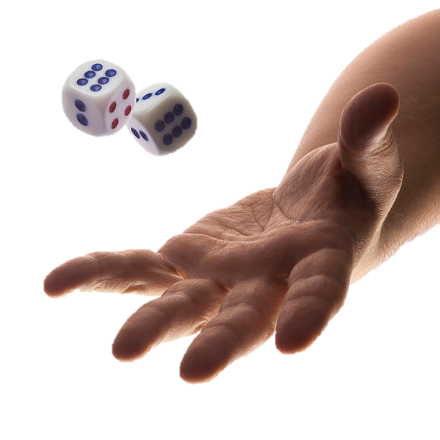
The Dice Game
With a D20, get a 20.
The teller says the win multiplier is x15.
Do you play the game?

Slide 7
The Dice Game
With a D20, get a 20.
The teller says the win multiplier is x15.
Do you play the game?
With a D8, get an 8.
The teller says the win multiplier is x15.
Do you play the game?

Slide 8
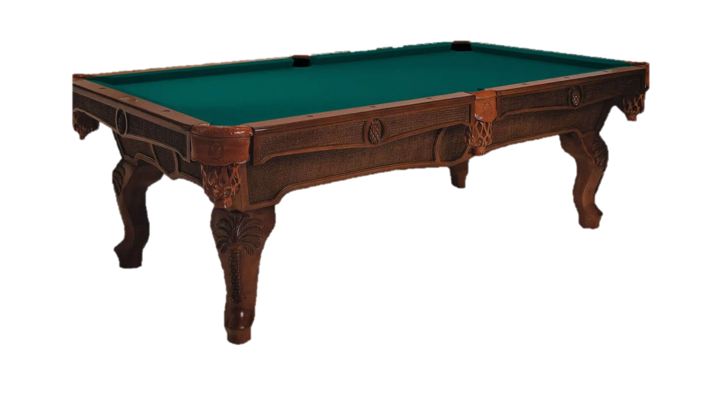
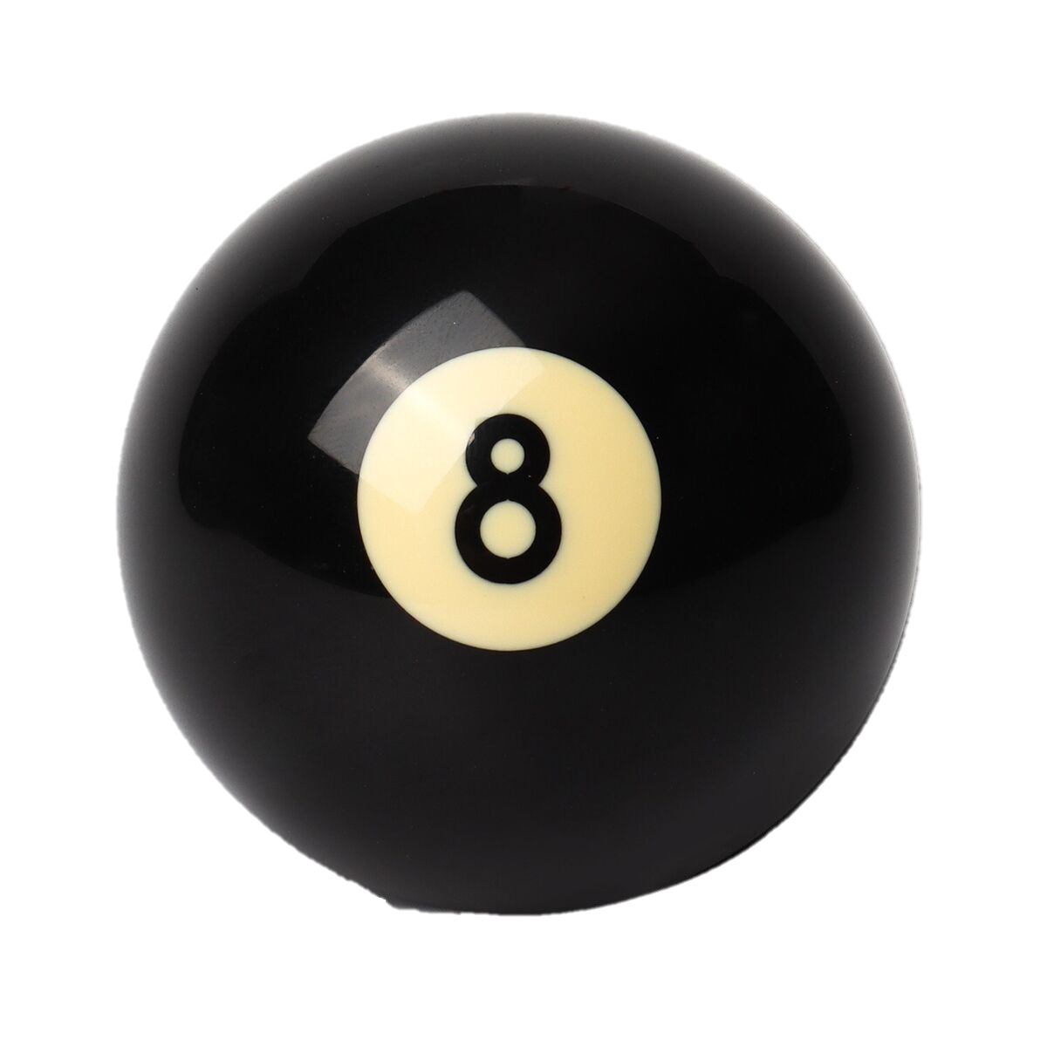
Everyone’s grouped up around a weird game?

Slide 9
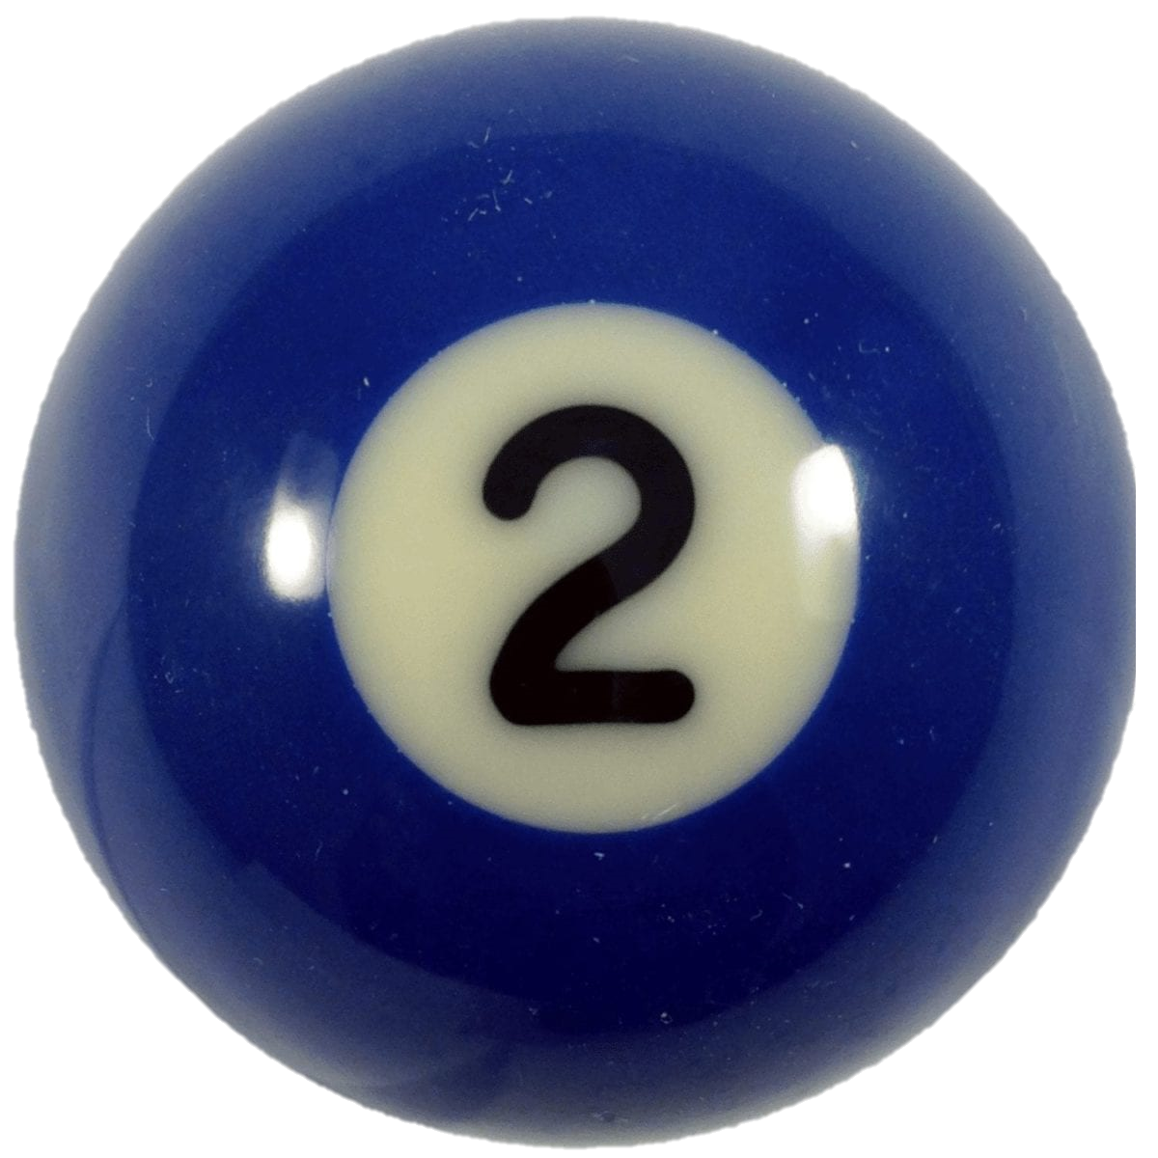
Teller Explains The Rules
1 ball is rolled on the pool table
A second ball is rolled
Winner is based on if ball is left or right of the 1st ball
Player 1 Wins
Player 2 Wins

Slide 10
Teller explains that you can still participate in the game
You don’t know the position of the 1st ball
You know that Anna has won 5 times, and Becca has won 3 times
Carol, an odds maker says:
IF Becca gets to 6 wins before Anna, I will give you a win multiplier of x15.
Do you take the bet?

Slide 11
How do you start to solve the problem?

Slide 12

You might start with
We don’t know where the ball is. But we have some amount of information of where the ball is. We can build a model based on the data…
$\hat{p}=5/8$
5/8
3/8
p = distance of ball
= probability Anna wins

Slide 13

Bet is first to 6 wins
$\hat{p}=5/8$
Anna has 5 wins, needs 1 win
Becca has 3 wins, needs 3 wins
P(Becca reaches 6) = (3/8) * (3/8) * (3/8) = 0.053 ≈ 1/19

Slide 14


Slide 15
BIGGER ISSUE IN PHILOSOPHY OF SCIENCE
We have data, and we built a model around the data
We don’t know how the world works (where the ball is)
We collected data to try to understand the world (model it)
AND THEN WE MAKE BIG CONCLUSIONS ABOUT IT
We try to incorporate uncertainty after the fact
Plus or minus based on model

Slide 16
KEY BAYESIAN INSIGHT Incorporating uncertainty of the model

Slide 17
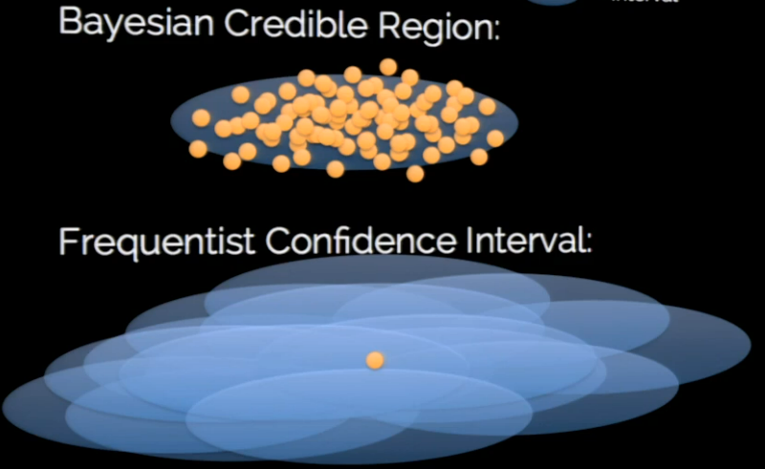

We chose $\hat{p}$ because it was most likely, and that’s true
Don’t think about probability of the data given a model
Think about probability of a model given data

Slide 18
So how would a Bayesian solve the problem?
Key concept. Incorporation of a nuisance variable
Treating statistics as a black box can be bad
Don’t just want to do a whole process, and see the distribution of the results

Slide 19
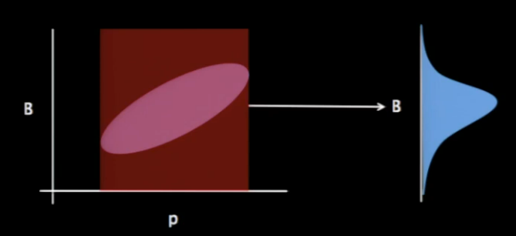
Key is to observe that the value of p and Becca’s chances of winning (getting 6)
Have to make calculation based on, across all values of p.
Rather than the likeliest p

Slide 20
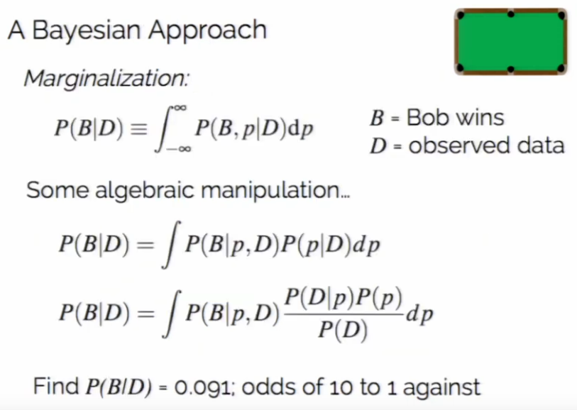
Classic example, don’t want to make it mathy
Key observation:
Always considering probability of
Becca winning BASED ON DATA
P(B|D)

Slide 21
Let’s see it in the simulations

Slide 22
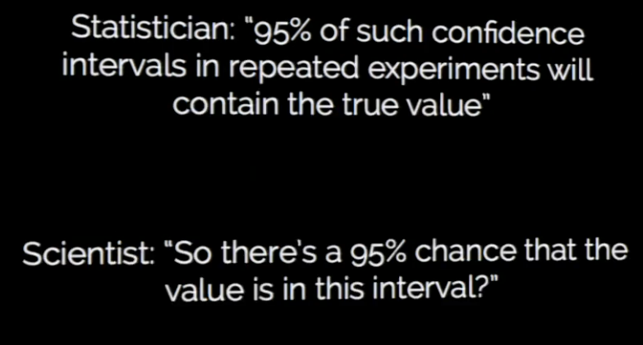
Typical Conversations
Slides and Inspirations from Jake VanderPlas (SciPy 2014)
https://www.youtube.com/watch?v=KhAUfqhLakw

Slide 23
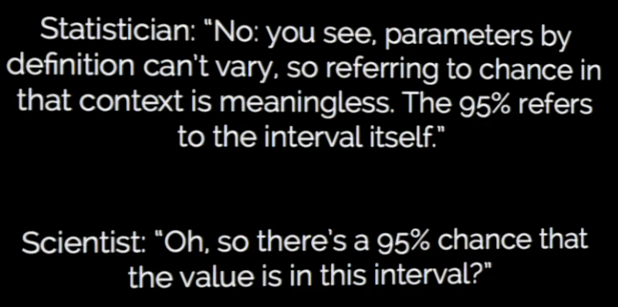
Typical Conversations
Slides and Inspirations from Jake VanderPlas (SciPy 2014)
https://www.youtube.com/watch?v=KhAUfqhLakw

Slide 24
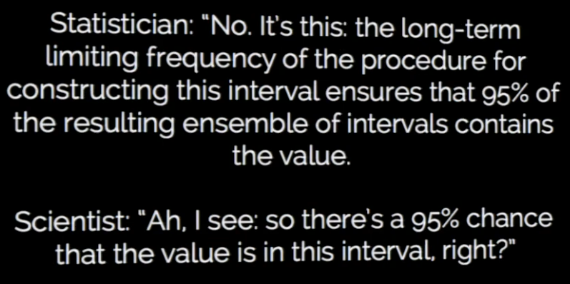
Typical Conversations
Slides and Inspirations from Jake VanderPlas (SciPy 2014)
https://www.youtube.com/watch?v=KhAUfqhLakw

Slide 25
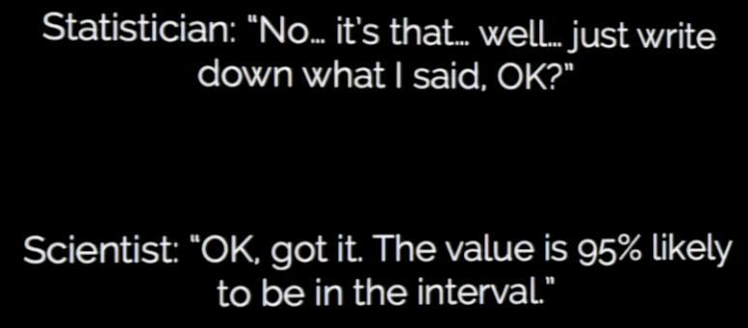
Typical Conversations
Slides and Inspirations from Jake VanderPlas (SciPy 2014)
https://www.youtube.com/watch?v=KhAUfqhLakw

Slide 27
Philosophy on Bayes Do we want to choose the 1 best model to fit the data? Or do we want to work with a distribution of models?

Slide 28
Rough Truths
Bayesian statistics is a lot more involved than frequentist (traditional) statistics
Also involves more “human touch”, hence includes subjectivity
(But technically all frequentist thoughts made a subjective choice to how we analyze statistics normally)
For simple problems, frequentists provide fair solutions and Bayes is too much effort for little return

Slide 29
Goal: Open your eyes to reflect on your understanding of probability and uncertainty If interested, consider looking up more Bayesian information

Slide 30

“Sometimes it lasts in love, but sometimes it hurts instead.”

Slide 31
NIKE PHOTOSHOOT CBVA MENS B BEACH VOLLEYBALL 2025/04/05
Photos @edellefs
Design @timtimmytimmeh

Slide 32
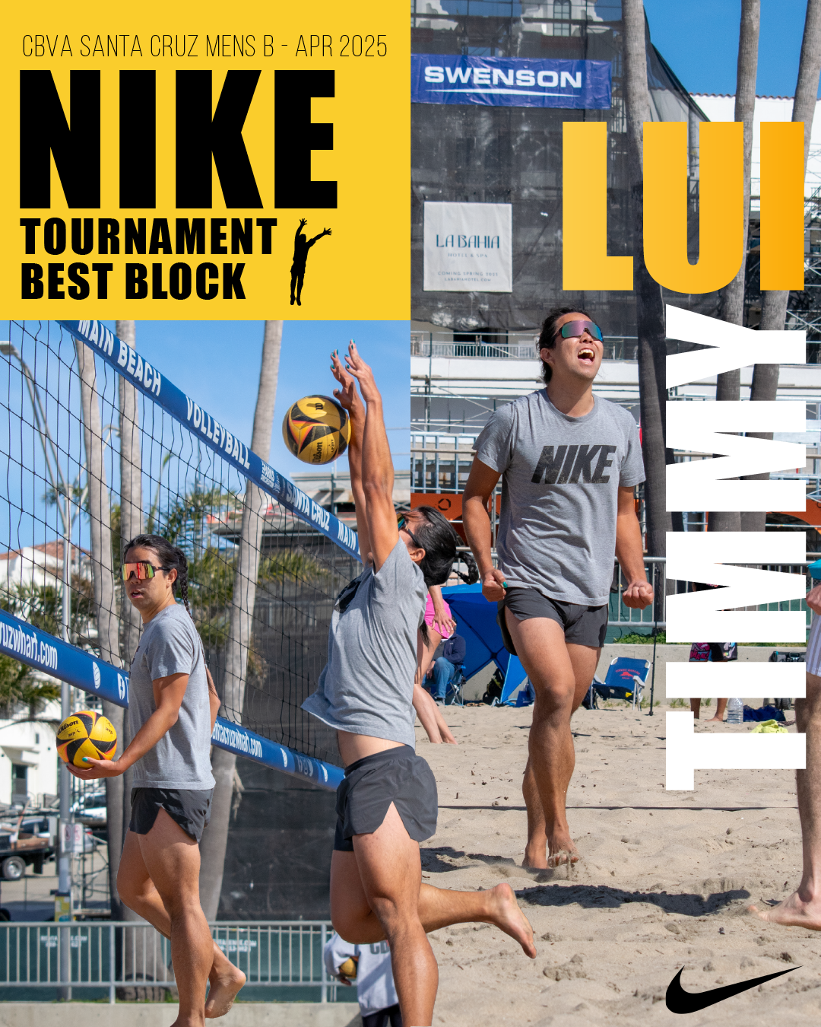
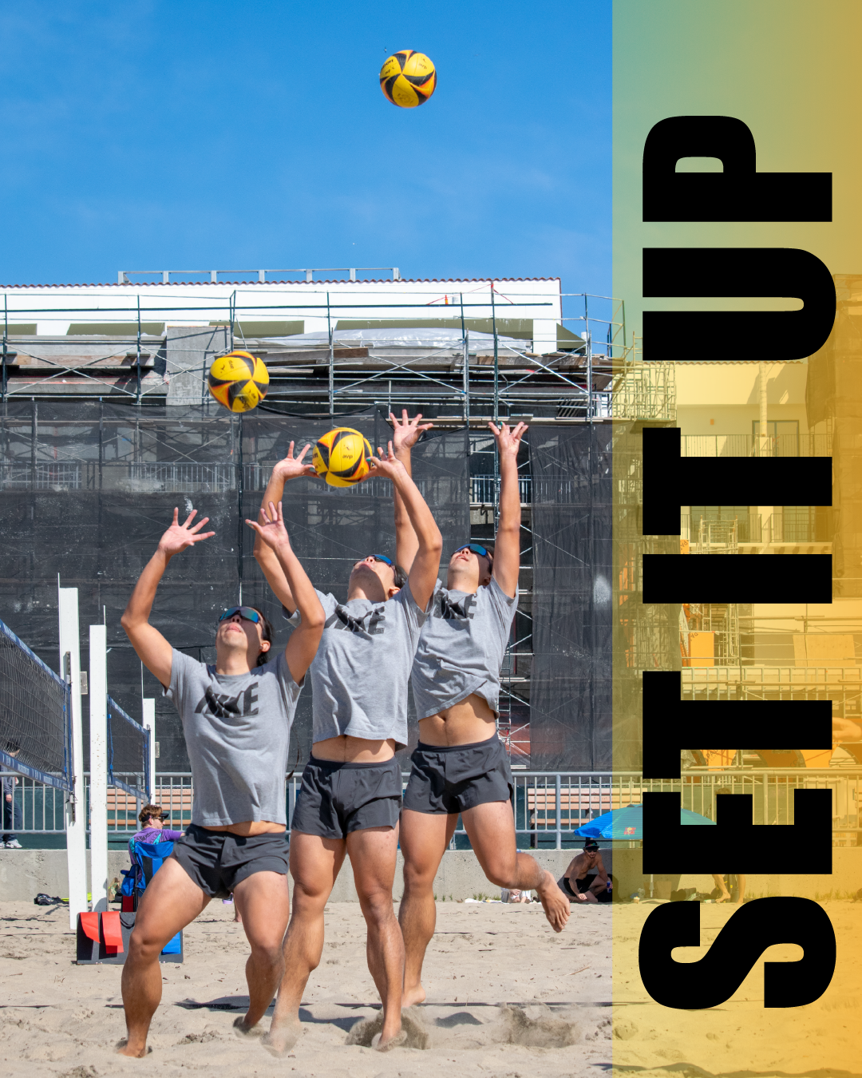

Slide 33
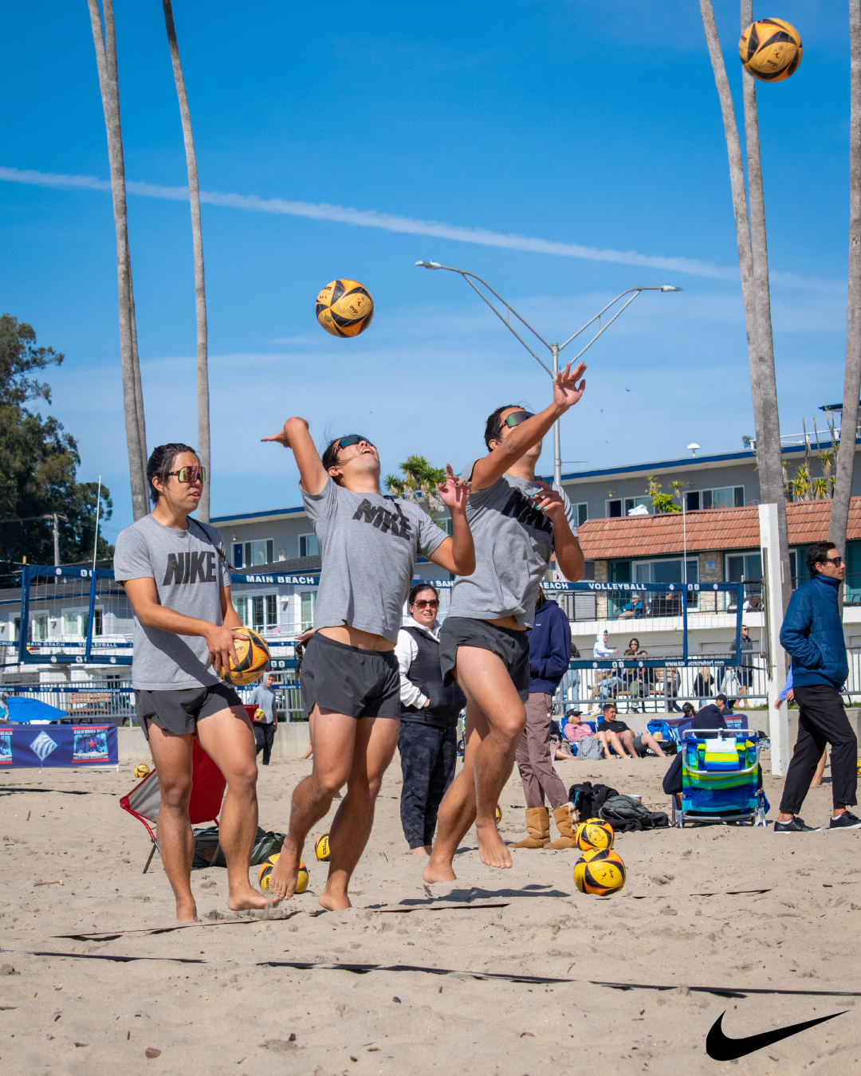
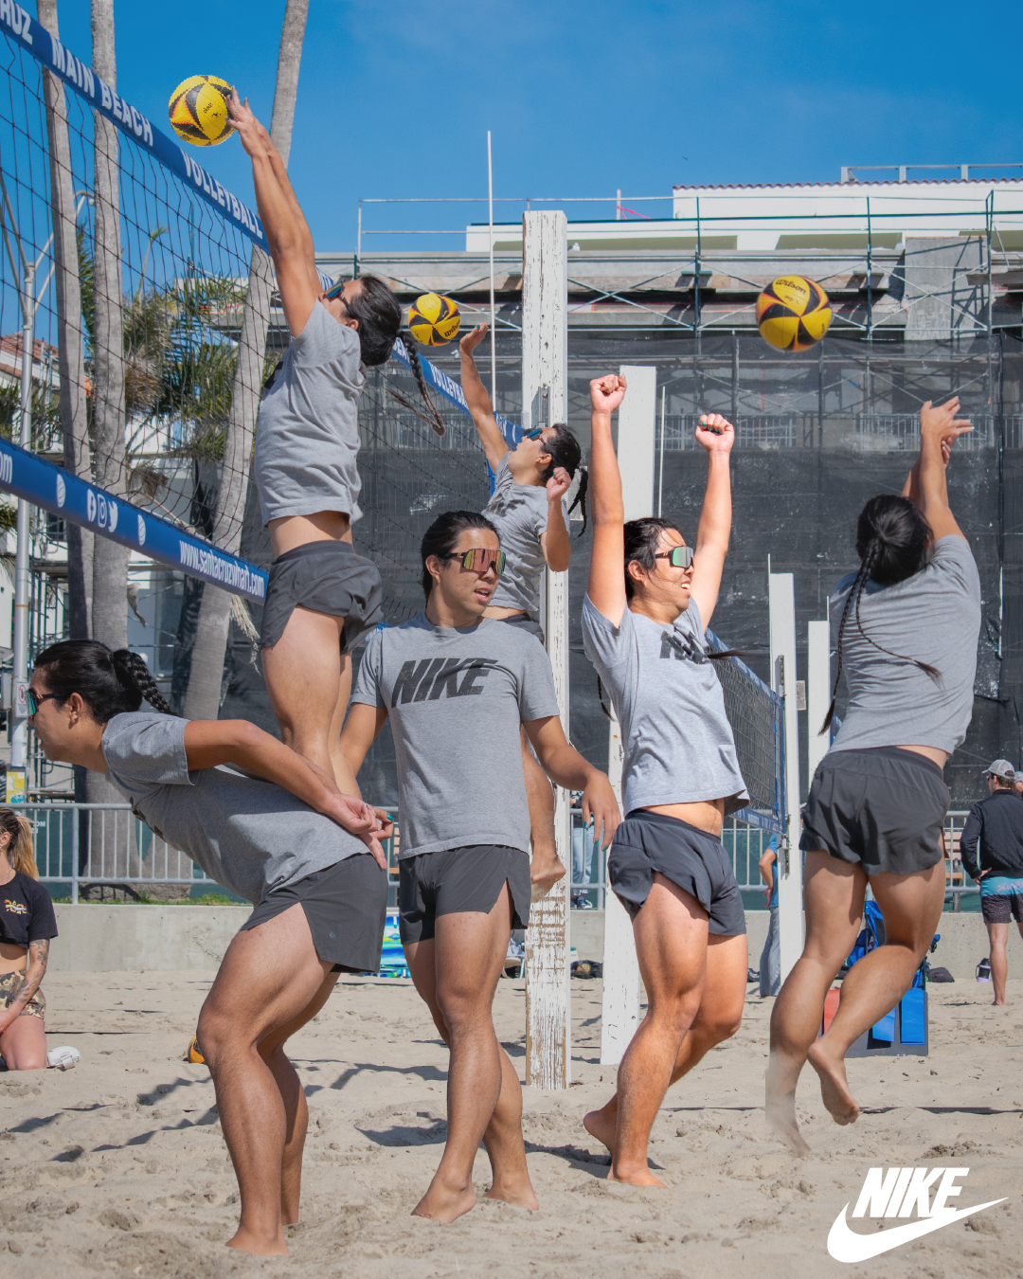

Slide 34
